Slide 1
FASAL
WEB
TECHNOLOGY
By-
SIDDART MADDI
CHIRAG KASHYAP S
AMOGH R K

Slide 2
WHAT IS FASAL?
Let’s start with the meaning of FASAL , which is a humble , generous helping hand to a farmer and also a helping hand to a vegetable and fruit vendor.
This helps in uplifting the economy of farmers and the vendors , as we are trying to take out the concept of middle men , from this website , as we don’t intervene in their financial deals .
From this website , we intend to improve the connection between the farmer and the vendor.

Slide 3
BUILDING COMPONENTS
Front-end : HTML , CSS , BootStrap , Java Script , JQuery
Back-end : PHP , MySQL , Xampp
Web-host : 000webhostapp.com
These are the major components used to build this website as they are linked with each other , internarily with their tags defined and externally with the source attribute.

Slide 4
FRONT END
Bootstrap has been used for the styling of top nav-bar , in every page and also for the pop-up forms and image cards in add crop and request crop have been made using bootstrap.
JavaScript and JQuery has been used in most of the pages to improve the functionality of the webpage , while hosting it on a server.
HTML and CSS are used for the basic layout of a page , so they are used at maximum in our website.

Slide 5
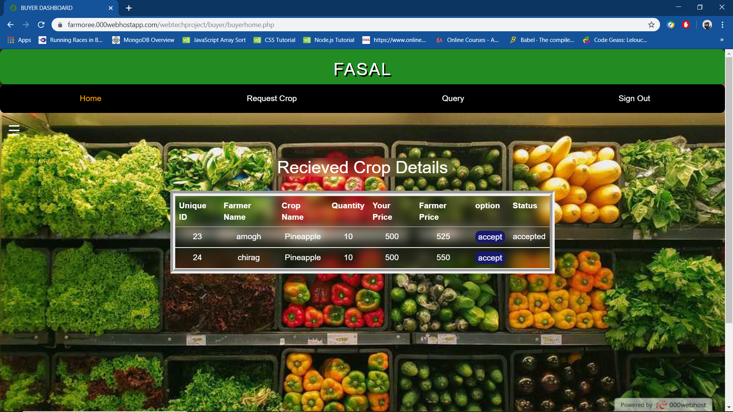
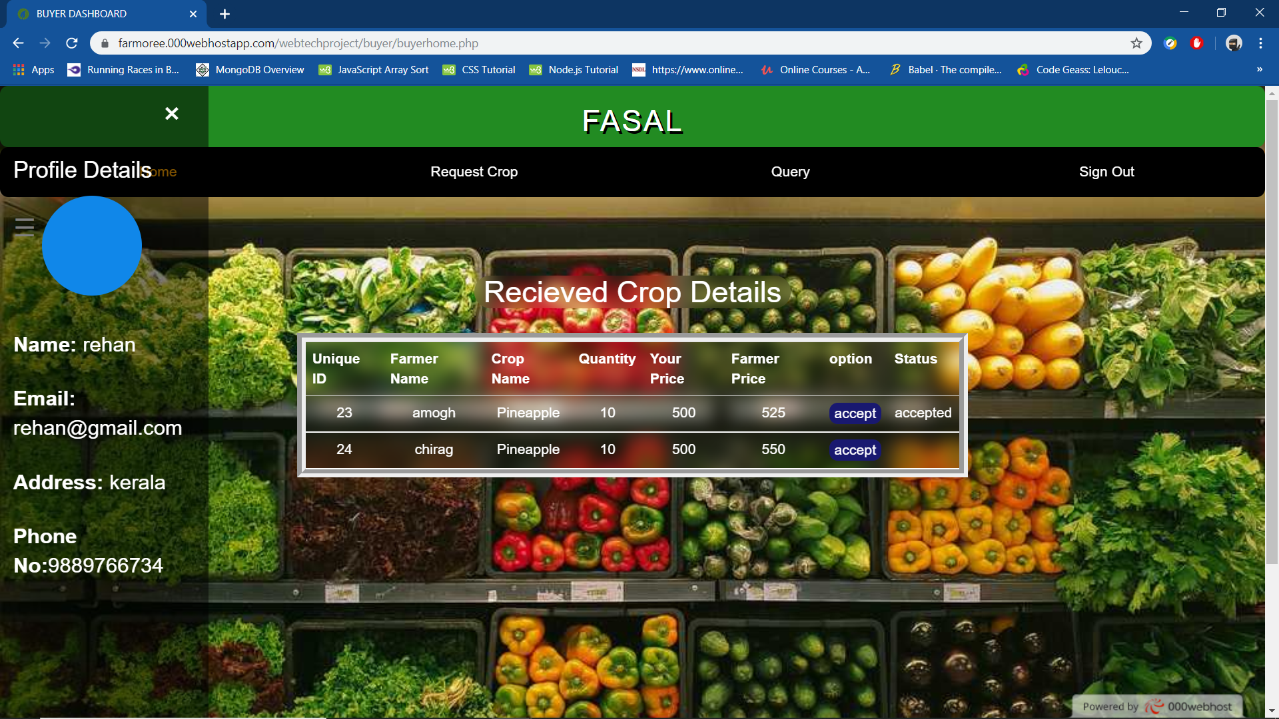
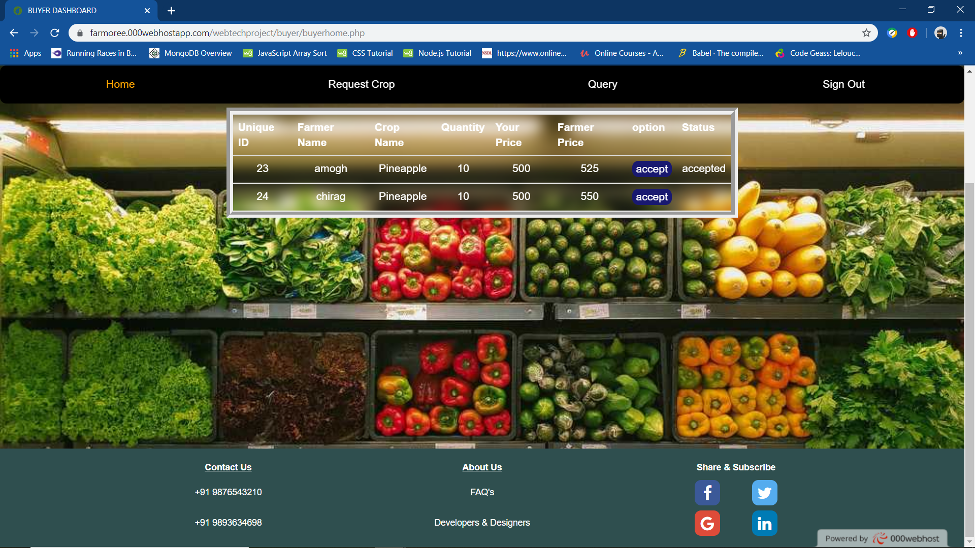
These are some of the screenshots of the website’s front end.
[Buyer Home]

Slide 6
BACK END
In backend , we have used PHP and MySQL , for creating database , which contains multiple tables , that store and validate information entered by the user .
The MySQL queries retrieve and write information into the table , inside the database .
Using PHP , we have declared cookies which stores the user personnel information and is used for login validation for both farmer and buyer.
PHP is also used for server side scripting , using <?php?>.

Slide 7
FUTURE IMPROVEMENT
E-commerce services can be added to the website , as the buyer and the farmer can transfer each other money , right after the their deal gets completed (Eg: PayPal,Paytm,GPay etc.).
Weather prediction can be sent as a notification , to the farmer and the necessary actions can be taken by the farmer for the improvement of his/her crops.
Based on the medicinal requirements for the growth of the plants , a machine learning model can be built to suggest the type of medicines required for the plant , based on the image of the plant.

Slide 8
THANK YOU

